Slide 1

Setting Up Your Development Environment on Windows
Dart SDK & Android Studio Installation Guide

Slide 2

Why This Setup Matters
Dart SDK: Powering Modern Apps
Android Studio: Your Development Hub
Smooth Workflow Guaranteed
Dart provides a fast, client-optimized language for developing high-performance Flutter applications, enabling seamless UI and backend integration.
As the official Integrated Development Environment (IDE) for Android and Flutter, Android Studio offers a comprehensive suite of tools for coding, debugging, and testing.
A correctly configured environment is crucial for efficient coding, building, and debugging, minimizing roadblocks and maximizing productivity.

Slide 3
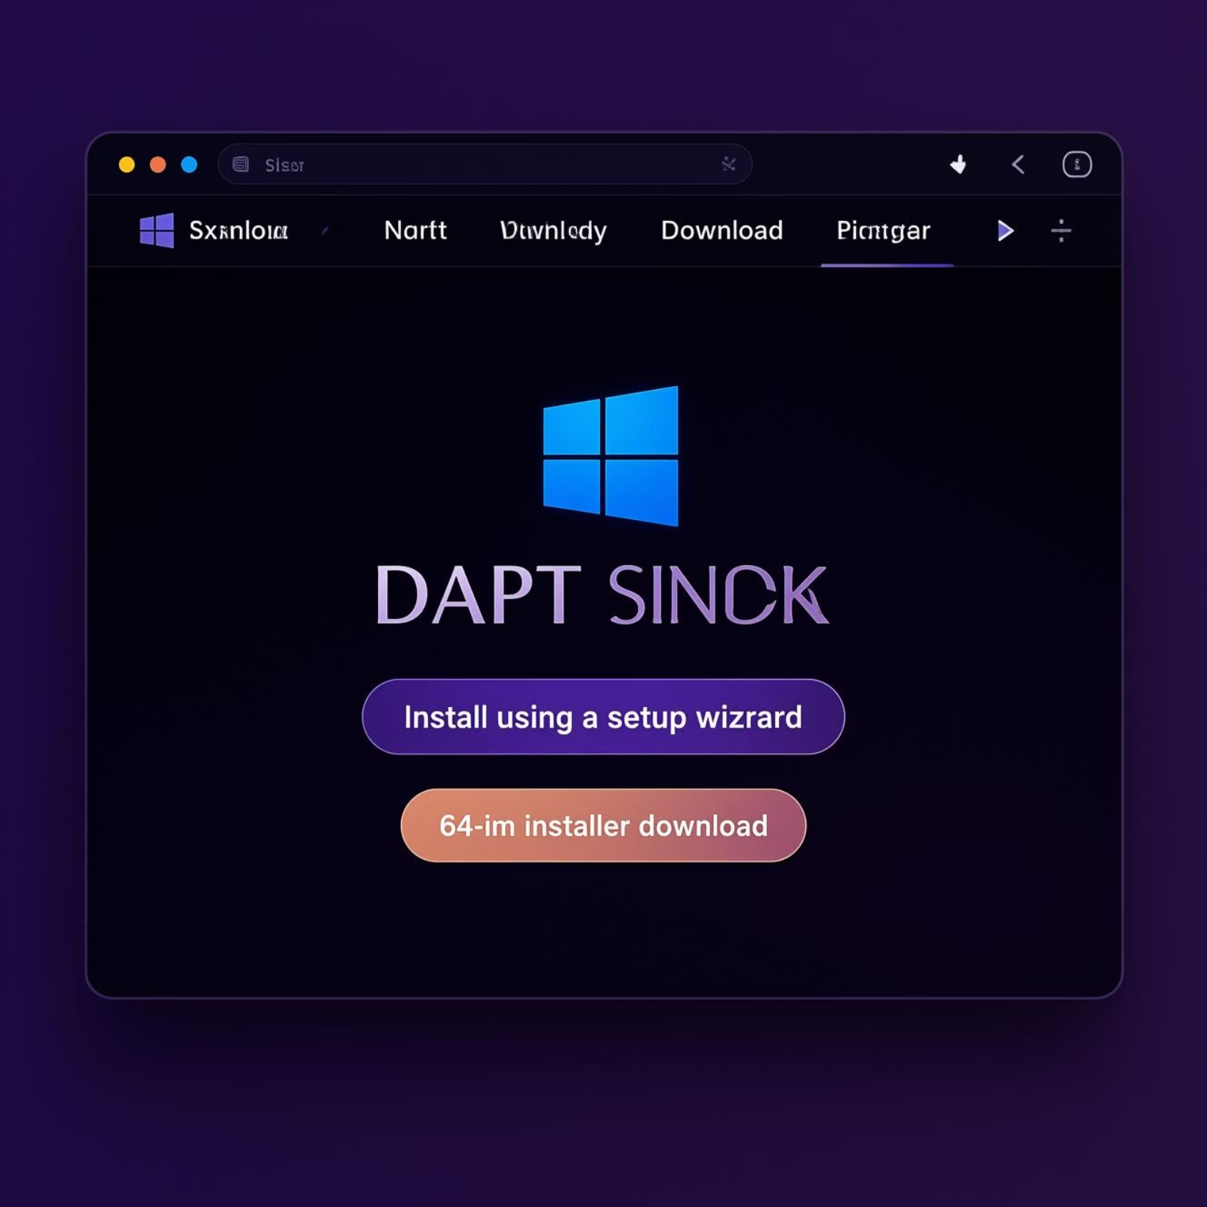
Step 1: Downloading the Dart SDK
To begin, navigate to the official Dart website. This is your primary source for the latest SDK releases.
Visit: https://dart.dev/get-dart
Select: Choose the Windows platform option.
Installer: Opt for the "Install using a setup wizard" to simplify the process.
Download: Get the Dart SDK installer specifically for 64-bit Windows.

Slide 4
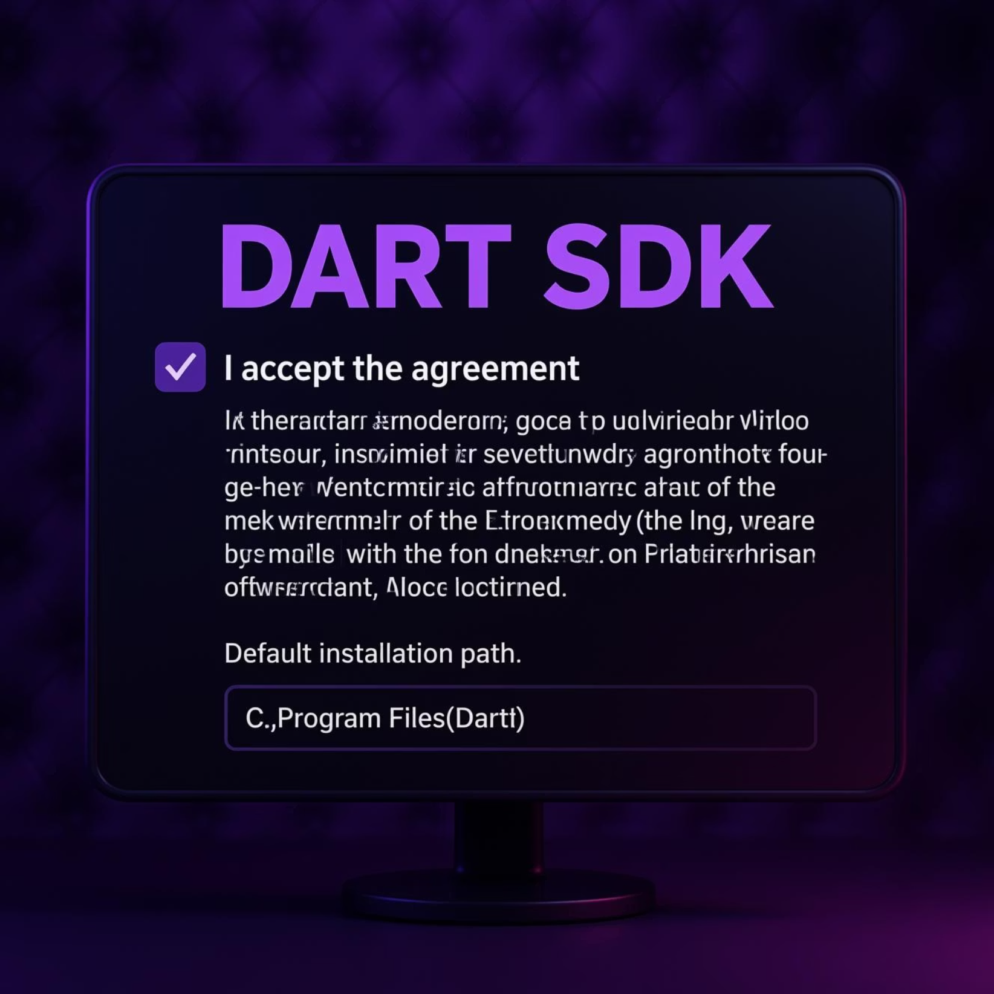
Step 2: Installing Dart SDK on Windows
Once the download is complete, proceed with the installation:
Run Installer: Launch the downloaded executable file.
License Agreement: Carefully read and accept the license terms.
Default Path: It's recommended to keep the default installation path (typically C:\Program Files\Dart).
Complete Installation: Follow the wizard's prompts until the process finishes.
Verify: Open a new Command Prompt and type dart --version to confirm a successful installation.

Slide 5
Step 3: Setting Environment Variables for Dart
1
2
Access System Properties
Edit PATH Variable
Right-click "This PC" > Properties > Advanced system settings > Environment Variables.
Under "System variables," find and select the Path variable, then click "Edit."
3
4
Add Dart Bin Path
Verify Installation
Add the path to your Dart SDK's bin folder (e.g., C:\Program Files\Dart\dart-sdk\bin).
Open a new Command Prompt and run dart --version to confirm global access.

Slide 6
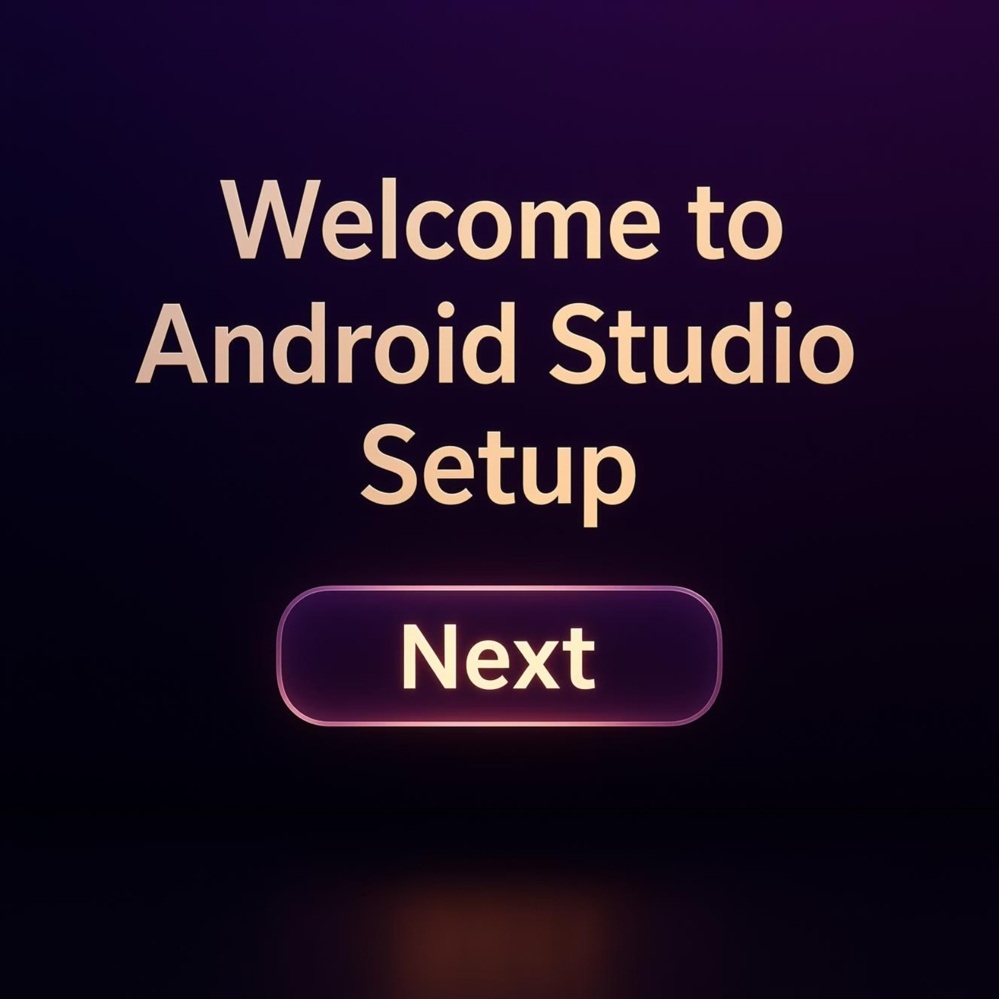
Step 4: Installing Android Studio
Android Studio is essential for Flutter development. Follow these steps for installation:
Download: Get the installer from the official site: https://developer.android.com/studio.
Run Installer: Launch the downloaded executable.
Default Options: Proceed with the default installation settings as recommended.
JDK Requirement: Ensure you have JDK 11 or higher installed; Android Studio typically bundles OpenJDK.

Slide 7
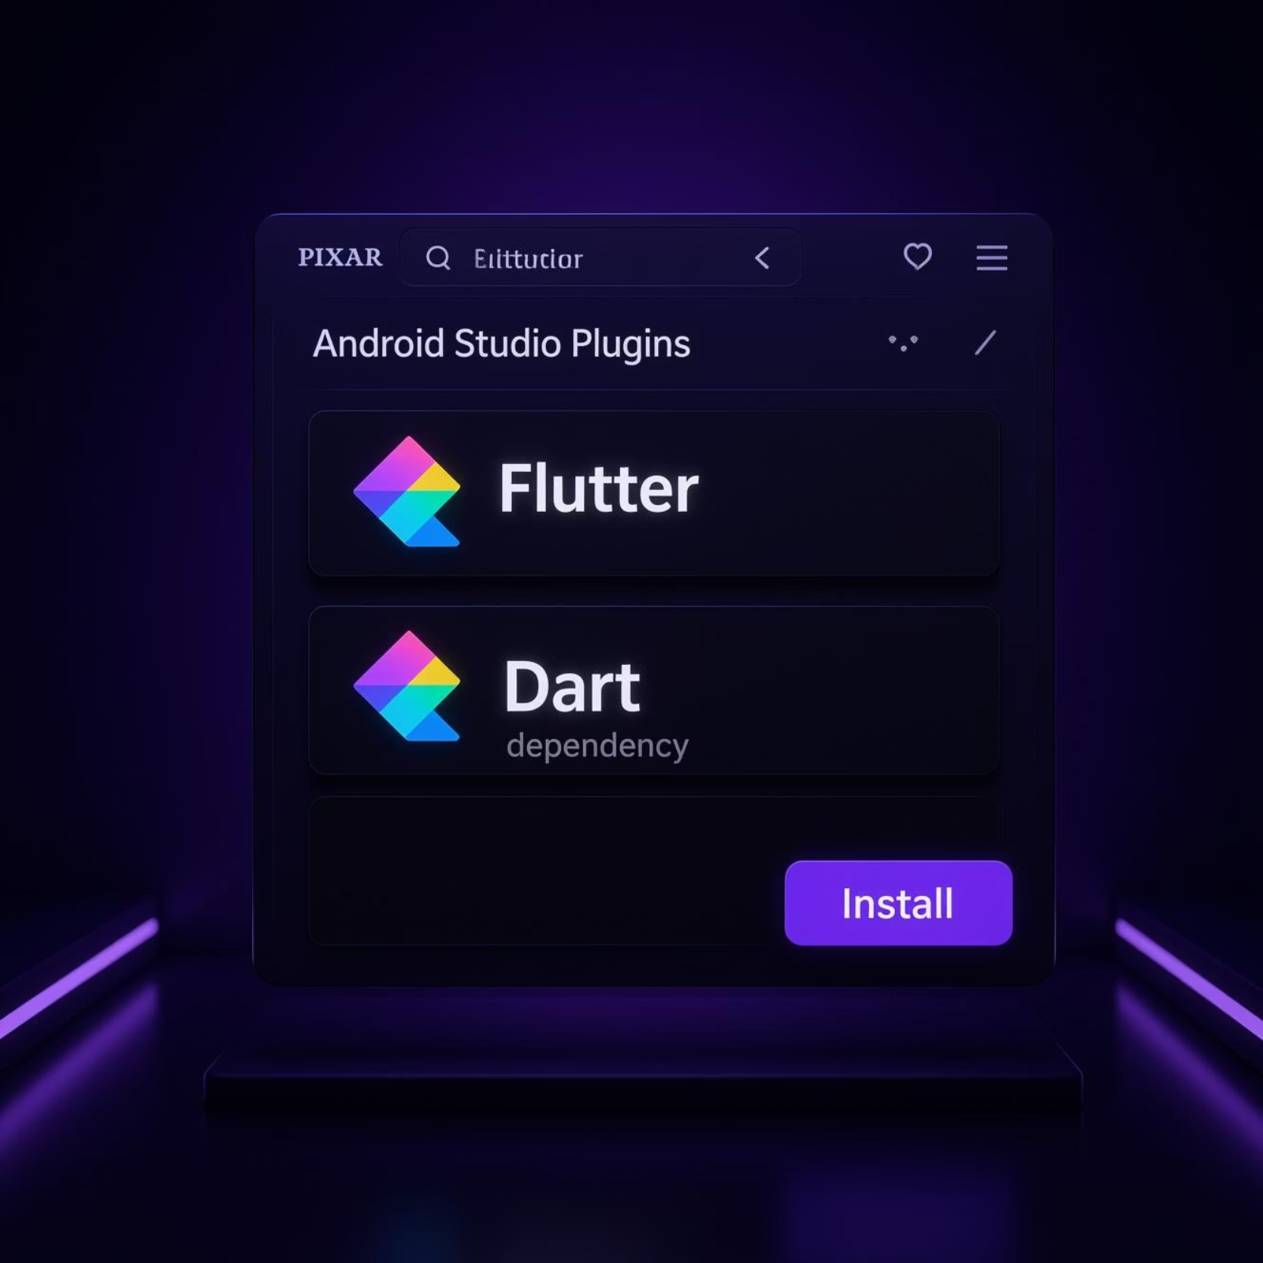
Step 5: Configure Android Studio for Flutter & Dart
Integrate Flutter and Dart capabilities into Android Studio:
Open Android Studio: Launch the IDE after installation.
Access Plugins: Go to Configure (bottom right) > Plugins.
Search & Install Flutter: In the marketplace, search for "Flutter" and install the plugin. This will automatically install the Dart plugin as a dependency.
Restart IDE: Restart Android Studio when prompted to apply the plugin changes.

Slide 8
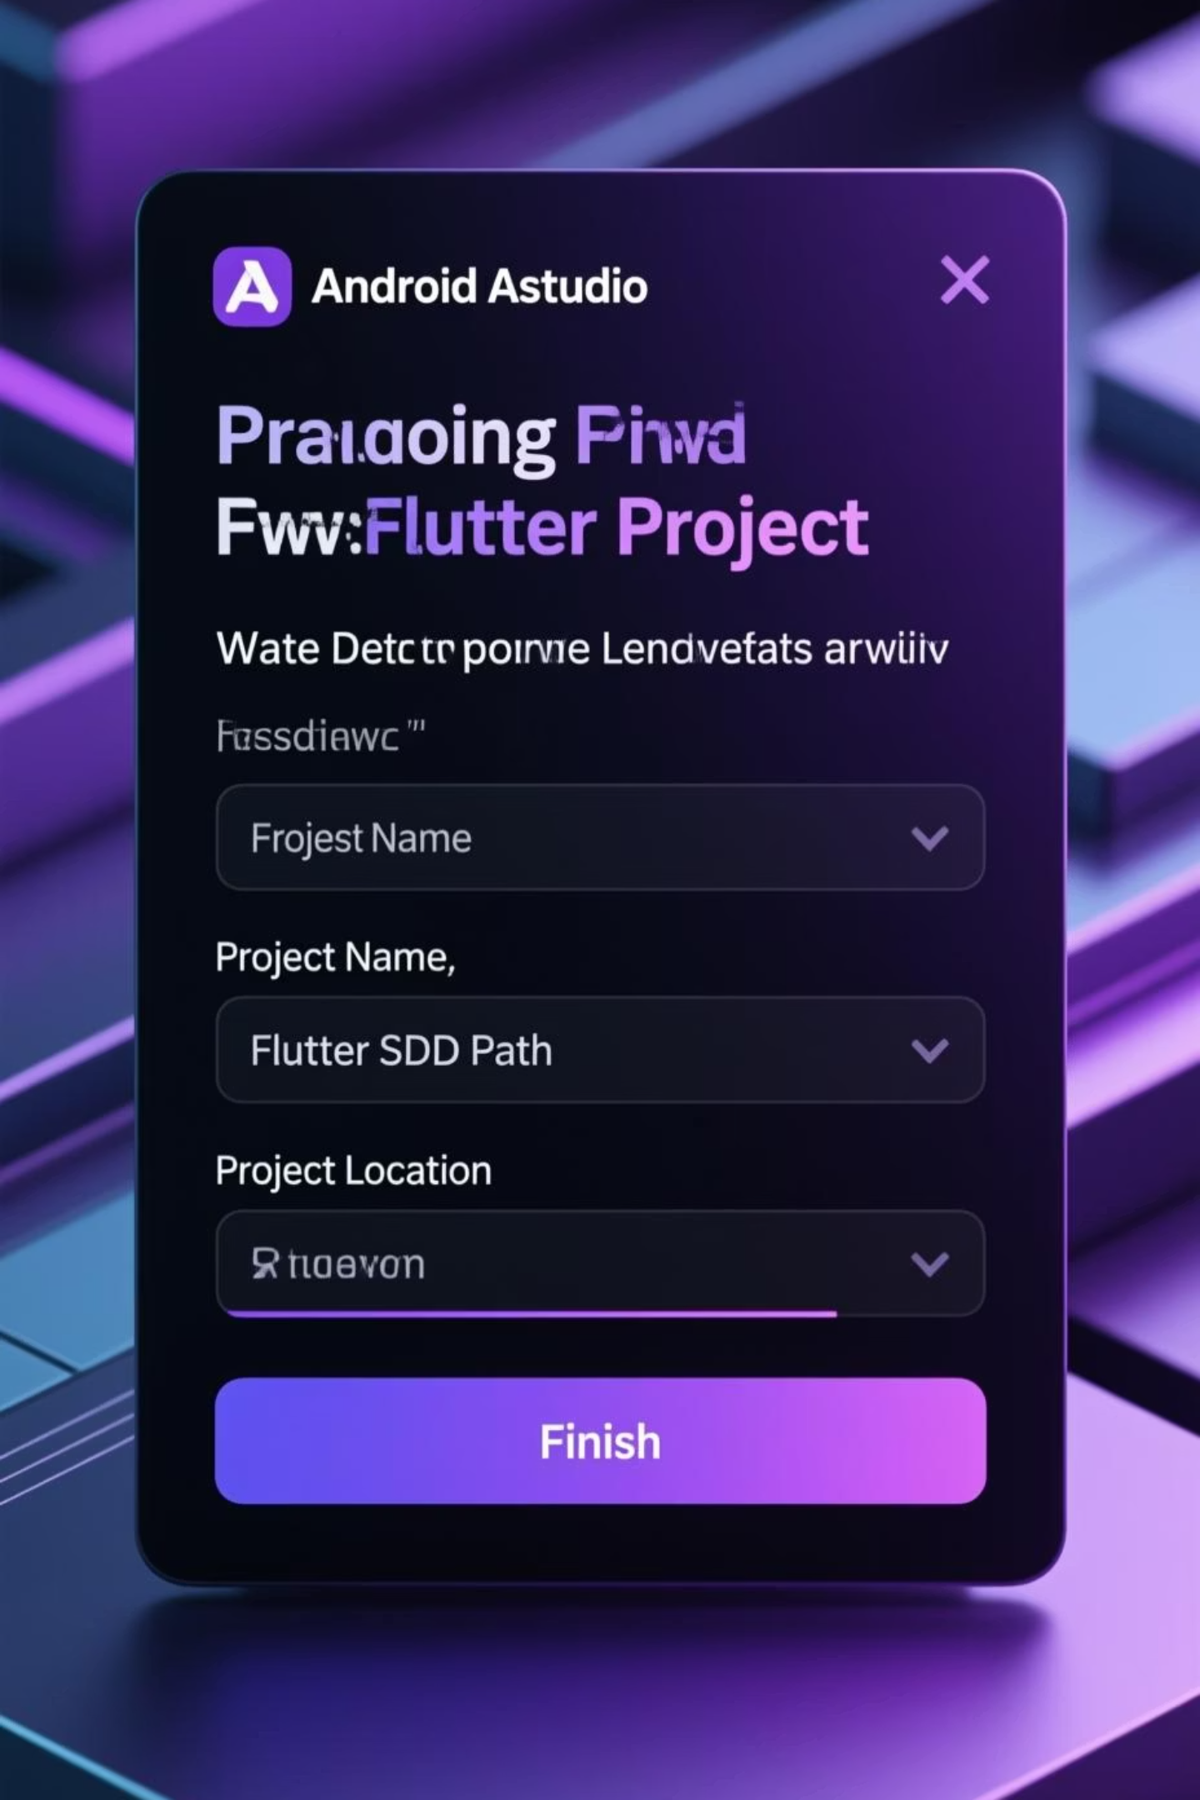
Step 6: Create a New Flutter Project
01
Start a New Project
From the Android Studio Welcome screen, select "Start a new Flutter project."
02
Choose Application Type
Select "Flutter Application" as your project type and click "Next."
03
Configure Project Details
Enter a suitable project name, specify the Flutter SDK path (download from flutter.dev if you haven't already), and set your desired project location.
04
Generate App Scaffold
Click "Finish" to create the basic structure of your new Flutter application.

Slide 9

Troubleshooting Tips
"Dart SDK is not configured" Error
If this message appears, navigate to File > Settings > Languages & Frameworks > Dart. Check "Enable Dart support" and manually set the Dart SDK path.
Verify Flutter SDK Path
Always double-check that the Flutter SDK path is correctly specified in your Android Studio preferences to avoid build issues.
Restart the IDE
After installing plugins or making changes to SDK paths, always restart Android Studio to ensure all configurations are properly loaded.

Slide 10
Ready to Build Your First App!
Congratulations! Your Windows development environment is now fully configured with Dart SDK and Android Studio. You're all set to dive into the world of Flutter development.
Start Coding with Flutter
Explore Official Documentation
Happy Coding!
Leverage Flutter's powerful features like hot reload for rapid development and its rich UI toolkit to create beautiful applications.
Unleash your creativity and begin building amazing cross-platform applications with Flutter!
For in-depth guides and resources, visit the official Flutter documentation: https://flutter.dev/docs.

